Slide 1
CSS/CSS3 – Step 4

Slide 2
CSS introduction
CSS : Cascading style sheet.
CSS provided lot of properties in the form of key-value pairs which help to apply formatting style for the web page.
Using CSS we can achieve separation of concern. Ie actual content and formatting style.

Slide 3
Types of css
Inline CSS
Internal CSS or embedded CSS
External CSS

Slide 4
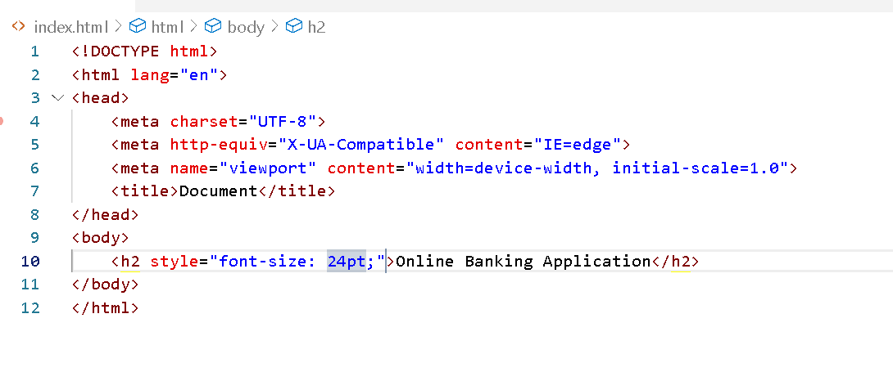
Inline CSS
Syntax
<tagName style=“property:value”>Content</tagName>

Slide 5
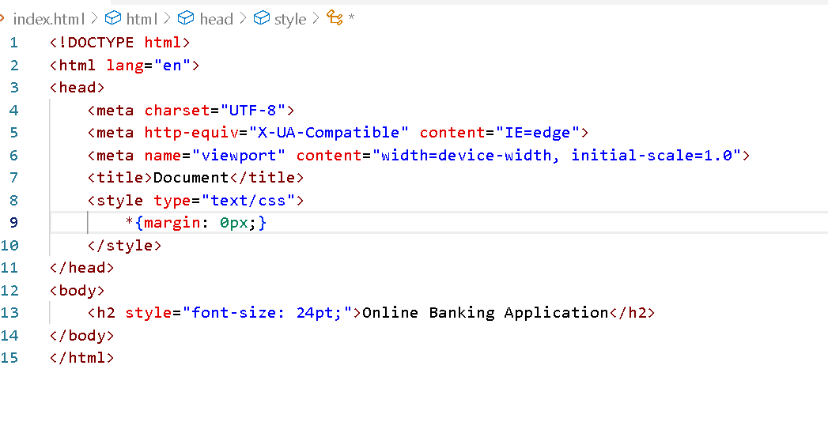
Internal or Embedded CSS
<style type=“text/css”>
*{margin:0px}
</style>

Slide 6
External CSS
Create external CSS file with different types of selector with more then one properties and values and connect this file in all web pages where you need to use it.

Slide 7
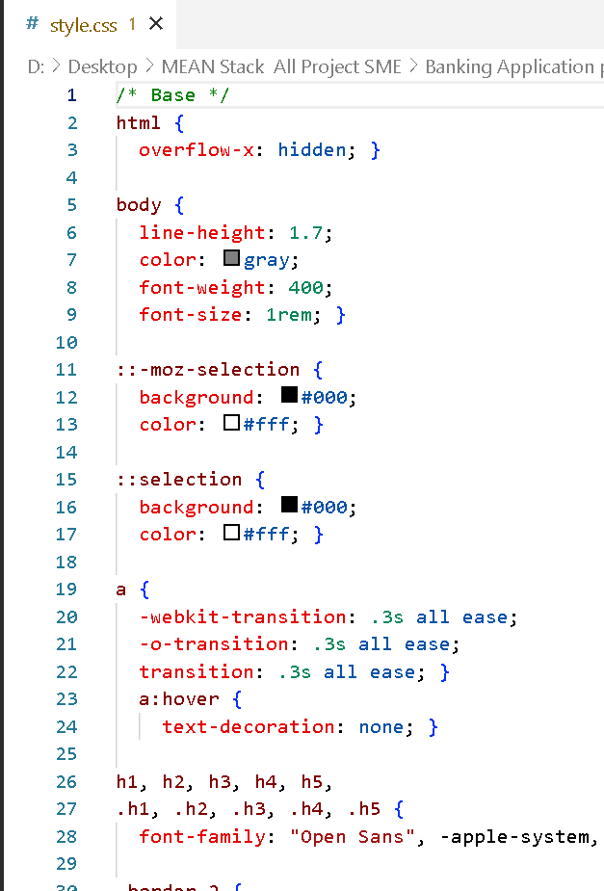
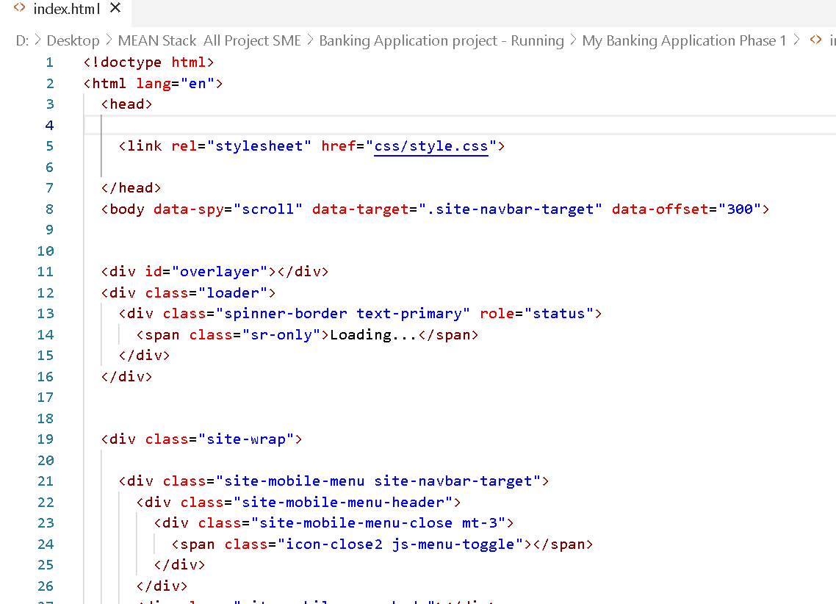

Slide 8
End of the css we expect
Apply static styling for all web pages using type of css ie internal or embedded or external.
As a good practice use one external css page with name styles.css.

